Slide 1
Scientific Prize Network
Connor Wooding

Slide 2
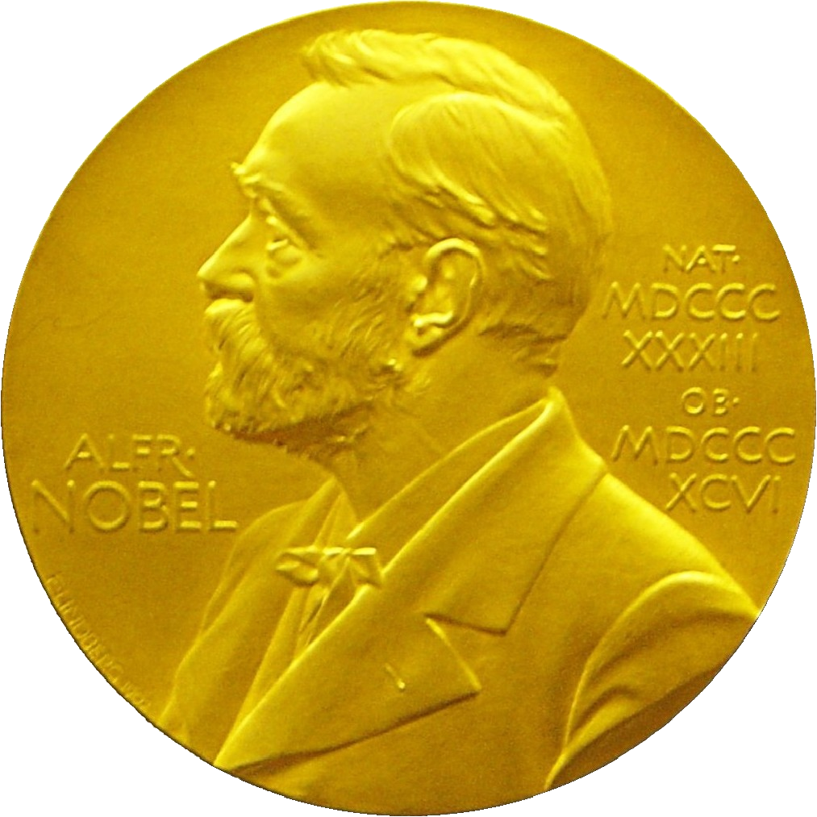
Agenda
Previous Research
My Research Plans
Current Results
Future Plans

Slide 3
Previous Research

Slide 4
The Paper
“Scientific prize network predicts who pushes the boundaries of science”
Yifang Ma and Brian Uzzi in the Proceedings in the National Academy of Science.
Paper explores various different networks of scientific prizes
Scientific prizes are awards given across different scientific disciplines that “confer credibility to persons, ideas, and disciplines, provide financial incentives, and promote community-building celebrations”
Two well known examples are the Nobel Prize and the Turing Award

Slide 5
Purpose
Scientific Prizes play a large role in advancing discoveries, but there has never been much quantitative analysis
From a network science perspective, look at how scientific prizes have evolved over time
Derive the statistical properties of global scientific prize networks
Look at growth dynamics over time
Discover how transition probabilities between prizes interlocks different disciplines and sub disciplines
Examine social network patterns among prizewinners
Explore both genealogical and co-authorship ties
Discover if likelihood is random or correlated amongst scientific elite in social network

Slide 6
Data Set Used
Comprehensive Data
Specific Prize Data
3062 scientific prizes
10,455 prizewinners
100+ years of winners
50+ countries
Publication and Citation Data
Institutional Affiliations
Years of Scientific Activity
Genealogical Relationships
Coauthorship ties

Slide 7
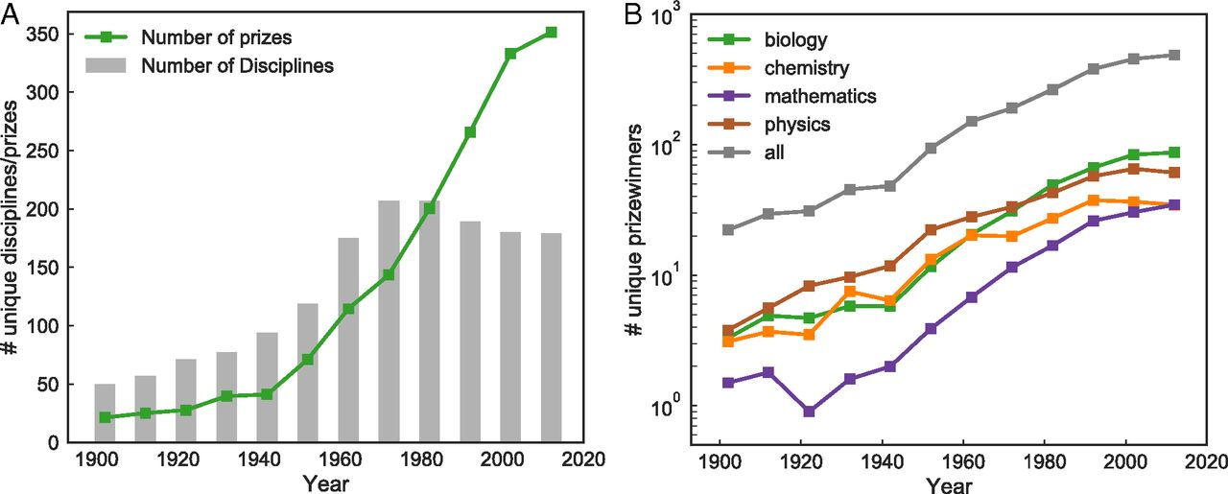
Growth of Prizes OVER Time

Slide 8
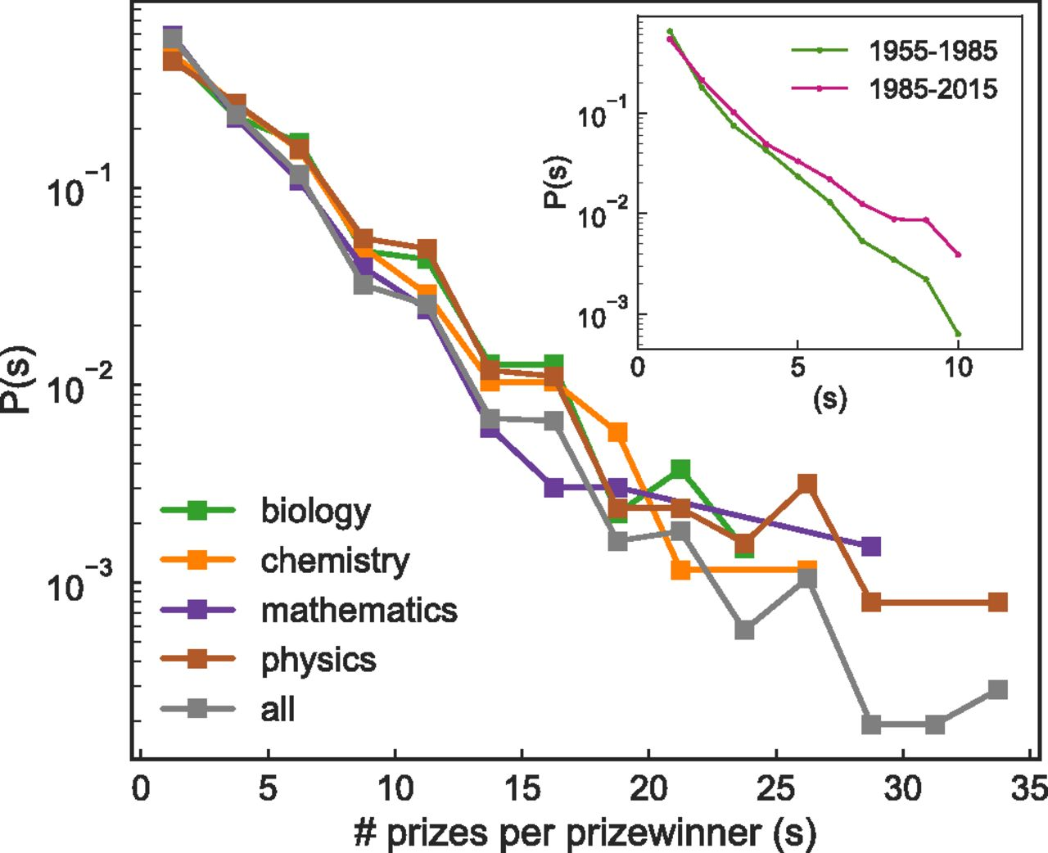
Prizes per Prizewinner
64.1% of winners have >2 prizes
13.7% of winners have >5 prizes

Slide 9
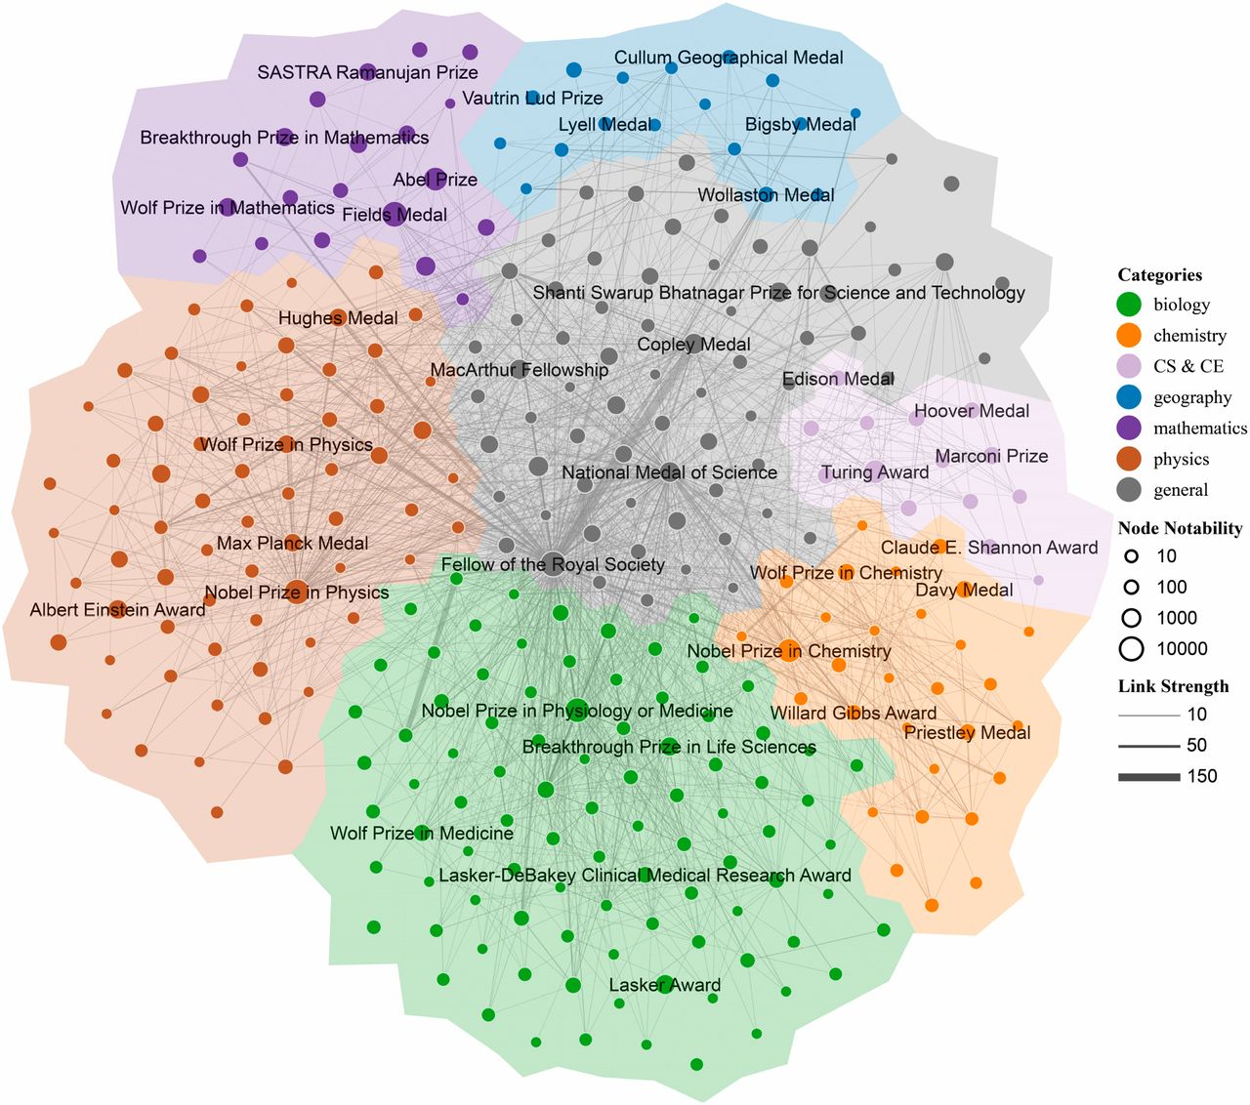
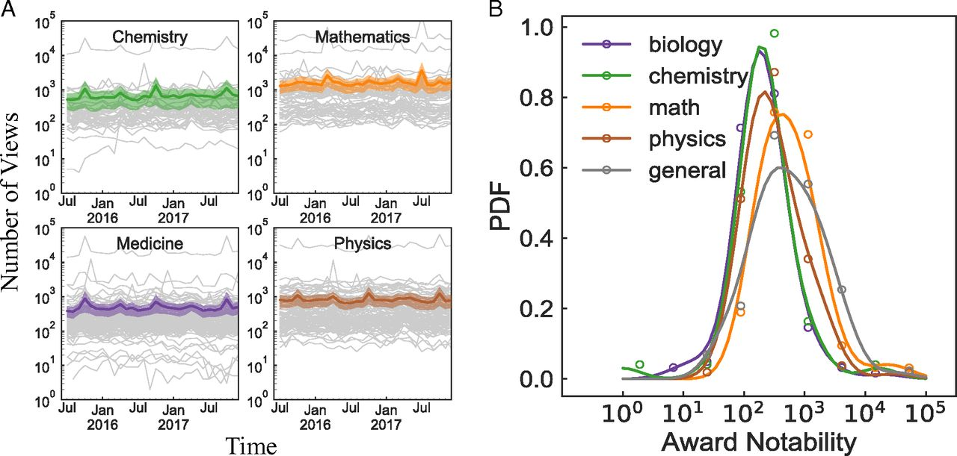
Scientific Prize Network

Slide 10
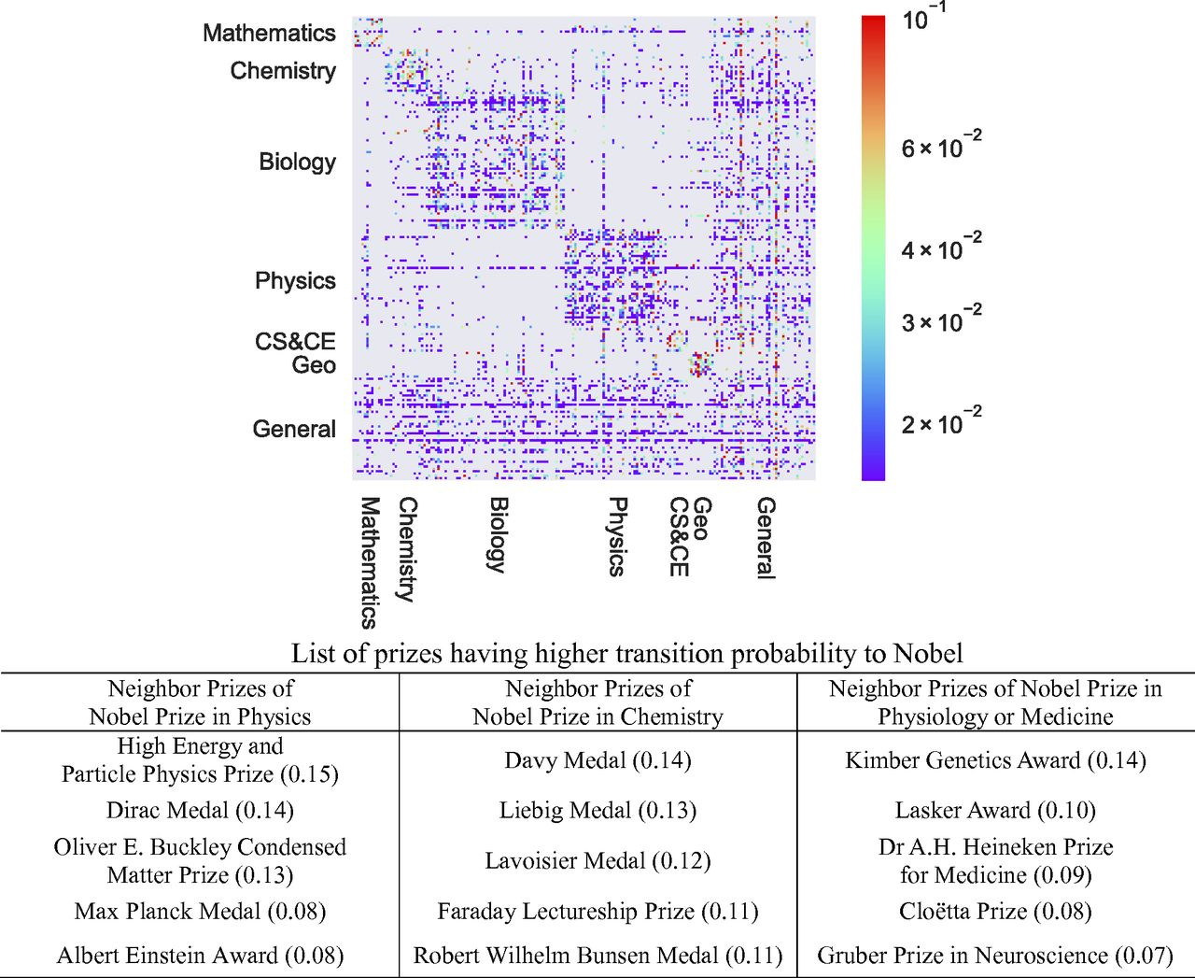
Scientific Prize Transition Matrix
Interlock is densest within disciplines
High transition probabilities are to similar nobility of awards not higher nobility
Certain interlocks occur between disciplines connecting them
Chemistry and Physics most interlocked
Math and Geography least interlocked
General Sciences integrate diverse sciences

Slide 11
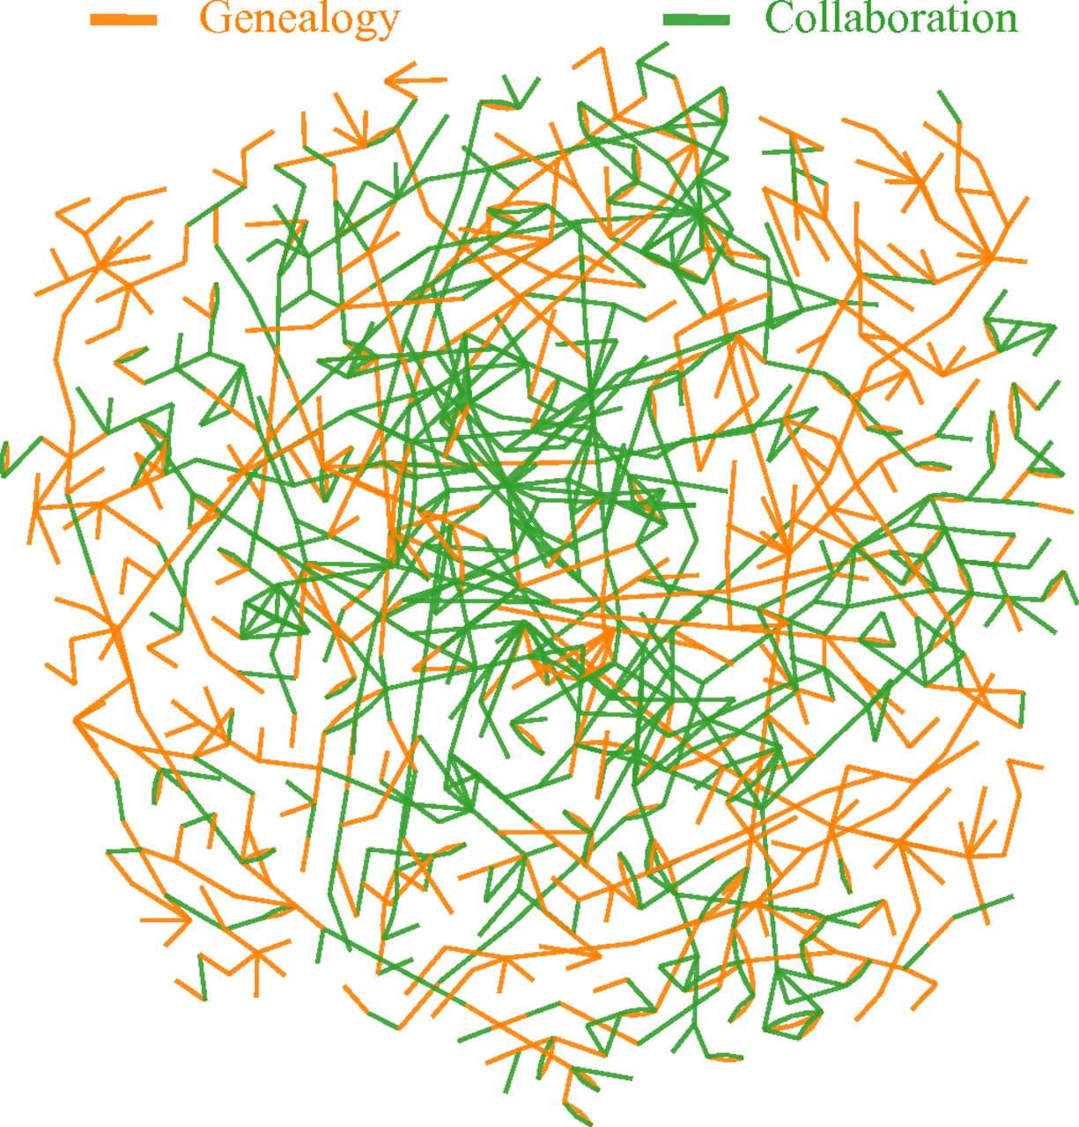
Social Network of Prizewinners
Investigate what role teamwork, information search, and access to novel ideas play
Social Network of 2034 winners with links for advisor-student and co-author relationships
Giant Connected Component (74% of winners)
Co-authorship ties densely packed in the center while genealogical ties are spread out
Interconnections among prizewinners span the globe, institutions, and time periods

Slide 12
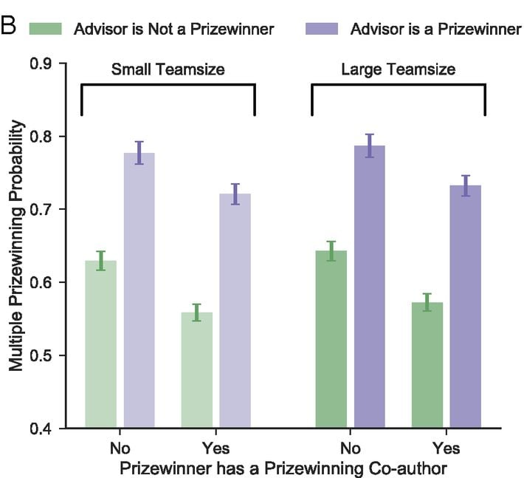
Predicting Multiple Prizewinners
University prestige positively related to multi-prizewinning
Number of publications not related to multi-prizewinning but average citation impact is. Quality > Quantity.
Genealogy positively associated with propensity for prizewinning
Having a prizewinning co-author reduces propensity for prizewinning

Slide 13
Final Conclusions
Able to quantitatively explain why the set of successful scientific individuals is increasingly made up of a smaller and more intertwined set of scientists
Future Work
Explain why explosive growth in scientific prizes have occurred. Deeper dive into the nature of prizes and stratification of science
Further work into how the scientific social networks form and effects that the concentration of prizes within these networks can have such as in-group biases and dominant learning processes
Discover how prize interlocks between disciplines influence knowledge transfer

Slide 14
My research plans

Slide 15
Overall Scientific Prize Network

Slide 16
Extensions to Scientific Prize Network
Computer Science Prize Network
Additional Metrics
Explore how scientific prize network applies to a specific discipline
See if patterns persist or if new ones arise
Newer + more intertwined discipline
Add in smaller prizes and scientists who are not prizewinners to fill in more gaps in the networks
Create social networks with shared institutions as a connection as well
Explore what institutions have the greatest impact on prizewinning to see if that is an area where success concentrates
Notability of prizewinners based on other metrics such as publication count and publication popularity

Slide 17
Dataset to be used
Association for Computing Machinery
World's largest educational and scientific computing society
Have awarded prizes related to computing every year since 1966
Different Categories:
Career-Long Contributions
Early-to-Mid-Career Contributions
Specific Contributions
Student Contributions
Regional Awards
SIG Awards

Slide 18
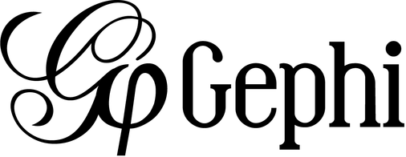
Tools To be Used
webscraper.io
Obtain Data
Python
Generate Statistics
Format Data
Gephi
Visualize Graphs

Slide 19
Current results

Slide 20
Data Set obtained
CS Prizes from ACM
CS Genealogy + Individual Metrics
31 unique CS prizes
6527 prizewinners
50+ years of prizes
Membership Awards
ACM Fellow
ACM Distinguished Member
ACM Senior Member
Top Colleagues
Affiliated Institutions
Other Metrics
Publication years
Publications count
Citations count
Cumulative paper downloads

Slide 21
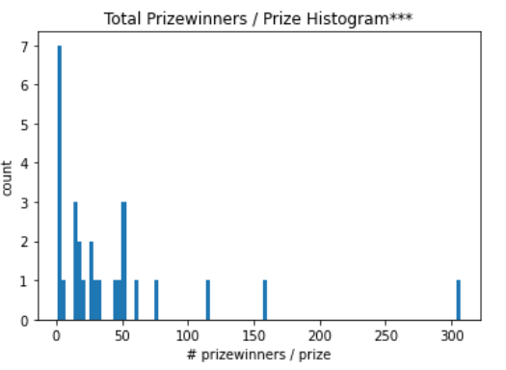
Prize Data Set Distribution
Majority of prizes have only been awarded to less than 50 people
210 winners / award average
3 Membership Awards
ACM Fellow - 1387
ACM Distinguished Member - 795
ACM Senior Member – 3144
*** Histogram excluding membership awards

Slide 22
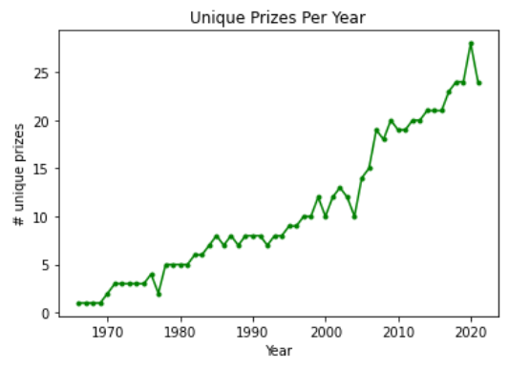
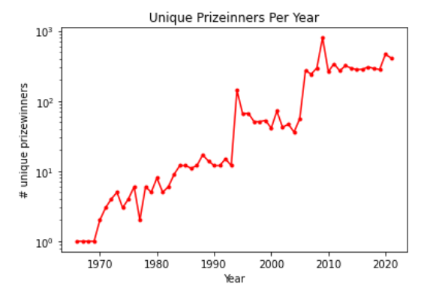
Growth of Prizes OVER Time
Follows same trend as overall prize network!

Slide 23
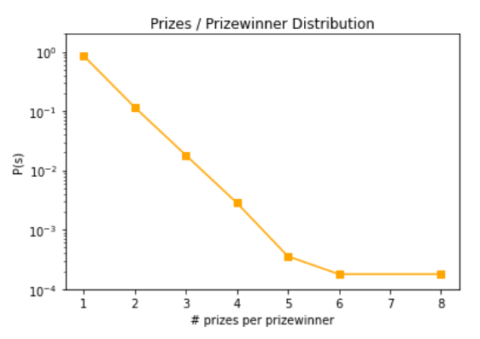
Prizes per Prizewinner
Similar linear trend to overall dataset
13.9% of winners have multiple prizes
Much less multi-prizewinners than overall prize network

Slide 24
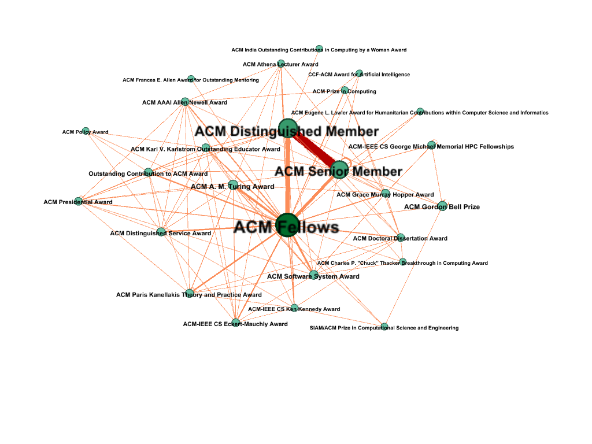
Computer Science Prize Network
Graph Statistics
# Nodes | 26
# Edges | 106
Connected Components | 1
Density | 0.33
Avg Degree | 8.15
Avg Weighted Degree | 86.1
Diameter | 3
Avg Path Length | 1.75
ACM Fellows Degree: 23

Slide 25
Computer Science Prize Network - no Members
Graph Statistics
# Nodes | 19
# Edges | 60
Connected Components | 1
Density | 0.35
Avg Degree | 6.13
Avg Weighted Degree | 20.1
Diameter | 4
Avg Path Length | 1.90
Turing Award Degree: 11

Slide 26
Propensity to Win Turing award
Award | # To Win Turing After | Transition Probability
ACM Fellows | 18 | 0.352941
ACM Software System Award | 11 | 0.215686
ACM Paris Kanellakis Theory and Practice Award | 7 | 0.137255
ACM-IEEE CS Eckert-Mauchly Award | 3 | 0.058824
ACM Grace Murray Hopper Award | 2 | 0.039216
ACM Karl V. Karlstrom Outstanding Educator Award | 2 | 0.039216
ACM Distinguished Service Award | 2 | 0.039216
ACM AAAI Allen Newell Award | 2 | 0.039216
ACM Athena Lecturer Award | 1 | 0.019608
ACM-IEEE CS Ken Kennedy Award | 1 | 0.019608
SIAM/ACM Prize in Computational Science and Engineering | 1 | 0.019608
ACM Presidential Award | 1 | 0.019608
Transition Probability Definition: For a given Turing Award winner, which other award is most likely to have been won by that winner prior to winning the Turing Award. 51 Total Prior Awards.

Slide 27
Propensity to Win Turing award
Award | # To Win Turing After | Total Winners | %
ACM Fellows | 18 | 1387 | 1.29
ACM Software System Award | 11 | 158 | 6.96
ACM Paris Kanellakis Theory and Practice Award | 7 | 61 | 11.48
ACM-IEEE CS Eckert-Mauchly Award | 3 | 44 | 6.82
ACM Grace Murray Hopper Award | 2 | 49 | 4.08
ACM Karl V. Karlstrom Outstanding Educator Award | 2 | 32 | 6.25
ACM Distinguished Service Award | 2 | 52 | 3.85
ACM AAAI Allen Newell Award | 2 | 31 | 6.45
ACM Athena Lecturer Award | 1 | 17 | 5.88
ACM-IEEE CS Ken Kennedy Award | 1 | 14 | 7.14
SIAM/ACM Prize in Computational Science and Engineering | 1 | 17 | 5.88
ACM Presidential Award | 1 | 27 | 3.70
Percentage Definition: For a given award, what percentage of its award winners went on to win a Turing Award. “Weights” propensity of winning Turing based on “size” of the award.

Slide 28
CS Prize Network Conclusions
Similar trends in data to overall prize network
Less multi-prizewinners which could be attributed to:
Less years of prizes
More smaller prizes considered
CS is more competitive
Only using a subset of awards (Missing IEEE, Independent Awards)
Prize network is very connected and centered around prizes of higher notability as well as prizes that are awarded more often
Propensity to win Turing Award came from the more notable and more often awarded prizes

Slide 29
Turing Award Colleague Network
Graph Definition:
Directed edges represent top 9 colleagues for award winners
Large vertices = award winners (75)
Small vertices = top colleagues
Statistics:
# Connected Components: 32
Size of Largest CC: 25
# “Isolated” Winners: 20

Slide 30
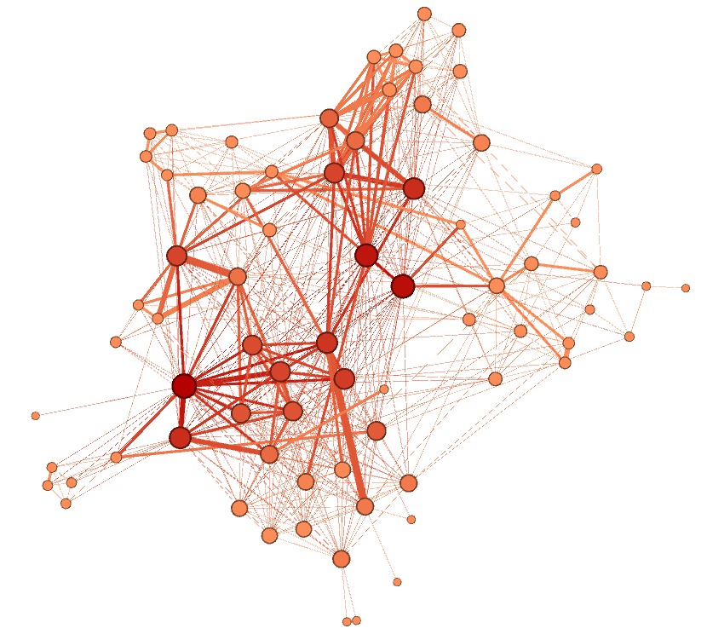
Turing Award Shared Institution Network
Graph Definition: Edges represent shared institutions between award winners
Graph Statistics
# Nodes | 74
# Edges | 577
Connected Components | 1
Density | 0.21
Avg Degree | 15.6
Avg Weighted Degree | 18.9
Diameter | 5
Avg Path Length | 2.01
*** Only 1 Winner Not in Graph! Joseph Sifakis from France (2007)

Slide 31
Turing Award Top Institutions
Institution | Turing Award Winners
Stanford University | 20
Massachusetts Institute of Technology | 15
University of California Berkeley | 14
Carnegie Mellon University | 9
International Business Machines | 8
MIT Computer Science & Artificial Intelligence Laboratory | 8
Hewlett-Packard Inc. | 7
Nokia Bell Labs | 7
Princeton University | 6
IBM Thomas J. Watson Research Center | 6
Delft University of Technology | 5
University of Illinois Urbana-Champaign | 5
Harvard University | 5
Microsoft Research | 5

Slide 32
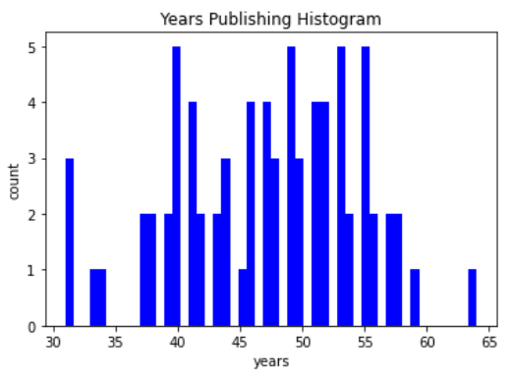
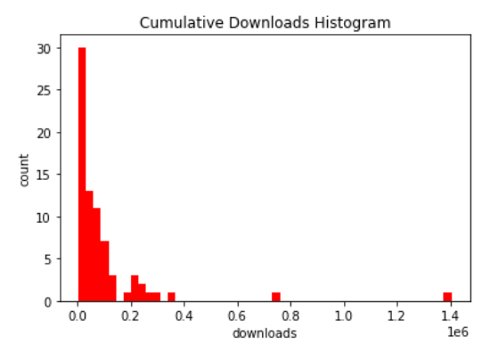
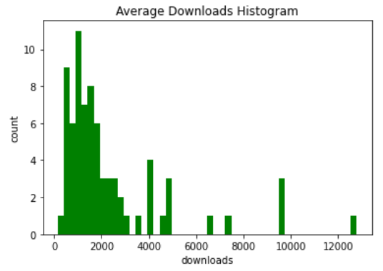
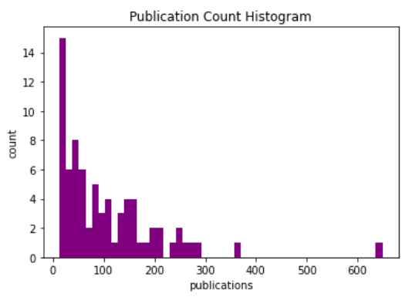
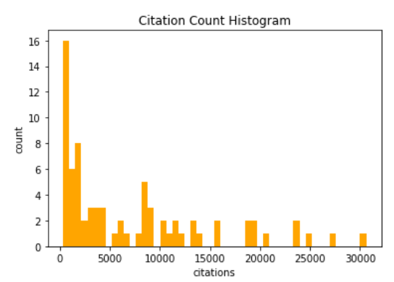
Turing Award Winners metrics
Takeaways:
Even among the top award winners, there are individuals that stand out
Positive correlation between metrics & institution network degree

Slide 33
CS Prize Social network Conclusions
Colleague network
Suggests a connection between 1/3 of Turing Award Winners
Smaller connections among other Turing award winners
Lots of Award Winners were isolated
Could be due to different areas of research
Could be due to different time frames
Could be since it is only the top colleague network
Institution network
Suggests a very strong connection among the best institutions
Almost all Turing Winners in this network
Top institution (Stanford) associated with 26% of winners

Slide 34
Future plans

Slide 35
Current Limitations
Dataset is only from ACM
Only has 31 prizes, 3 of which are member awards
Not including SIG (Special Interest Group) awards
Other institutions (e.g IEEE) and nations give out awards
Doesn’t include prizes won by CS specialists in other disciplines
Limitation of picking a specific discipline
Not much time-based statistics
Social networks done in a simplistic way without weighting strength of connections
Social networks are separated by colleagues and institutions

Slide 36
Future Work
Prize Network
Larger and vaster prize dataset
Generate time-based networks
Compute time-based statistics and predictions
Prizewinner Social Network
Generate social network for all prizes
Encode more information into social networks
Generate more statistics based on affiliated institutions
Combine social networks into one
Look for more patterns in metrics vs prizewinning

Slide 37
Thank You! Any Questions?

Slide 38
Citations
ACM. (2022). Association for Computing Machinery. From ACM Awards: https://awards.acm.org/
Ma, Y., & Uzzi, B. (2018). Scientific prize network predicts who pushes the boundaries of science. Proceedings of the National Academy of Sciences (PNAS).
Images:
https://en.wikipedia.org/wiki/List_of_Nobel_laureates_in_Physics
https://en.wikipedia.org/wiki/Association_for_Computing_Machinery
https://github.com/webscraperio
https://commons.wikimedia.org/wiki/File:Python-logo-notext.svg
https://en.wikipedia.org/wiki/Gephi
https://www.networkworld.com/article/2901680/database-pioneer-stonebraker-rocks-1m-nobel-prize-in-computing.html
https://identity.stanford.edu/visual-identity/stanford-logos/

